Slide 1

ECOSYSTEM SERVICES
Greg Huggins
DWA CORPORATE IDENTITY
Presented by:
Johan Maree
Deputy Director: Media Production
12 December 2012

Slide 2
Ecological Goods & Services Attributes (EGSA)
EGSA are the goods and services provided by the river (and associated ecological systems) that result in a value being produced for consumers. EGSA are now referred to as Ecosystem Services.
Provisioning services are the most familiar category of benefit, often referred to as ecosystem ‘goods’, such as foods, fuels, fibres, medicine, etc., that are in many cases directly consumed.
Other services include
  cultural services (ritual use of rivers, aesthetic or historical importance)
  regulating services (e.g. water quality inputs), and
  supporting services (e.g. nutrient formation)

Slide 3
Socio and Rural Economics
Concern as to how this has been dealt with - stakeholders, consultants, DWA
Concern possibly linked to use of terms and way in which results are presented
Stakeholders primary concern appears to be that what they term “rural economics” is a) poorly understood and b) potentially undervalued and c) not integrated into overall decision making process.

Slide 4
Socio and Rural Economics
Brief in this study is to look at two separate components (packages)of the overall “Socio-Economics” but to integrate in final analysis.
Package 1- Economics linked to market and broader economic parameters – more from William later
Package 2 – Ecosystem Goods and Services/Ecological Goods and Services Attributes (EGSA), Ecological Infrastructure = Ecosystem Services
“Rural Economics” how does this fit

Slide 5
Socio and Rural Economics
Our approach:
  Water abstracted from the river and utilised/value added falls within the ambit of “economics”
  Water that remains in the river but provides goods/services that generate value falls within the ambit of “Ecosystem Services”

Slide 6
Rural Economics
What does this mean?
Largely associated with the use that people derive from water and under circumstances that value is attached. Eg:
  Vegetable/home gardens that are watered
  Stock watering
  Taxi washing
  Small scale businesses – eg, hair salons
  Host of others

Slide 7
Rural Economics
For the most part these fall within the ambit of “Economics” as it is water that is abstracted from the river.
Not all of this may be accounted for as it forms part of the informal sector
Some of it is part of the Ecosystem Services – esp. some aspects of provisioning services

Slide 8
SCENARIO CONSEQUENCES: ASSESSMENT STEPS
STEP 1
STEP 2
Analyse the site – status quo.
Identify the communities likely to derive benefits from ESS
List the range of ESS available
Populate Ecosystem list and generate spreadsheet with biophysical input.
Fish and Veg: Abundance and importance for use (1- 5 score)
With stock watering, sand mining etc – link to provisioning services

Slide 9
SCENARIO CONSEQUENCES: ASSESSMENT STEPS
STEP 2 con
STEP 3: EVALUATE CHANGE PER SC
Regulating Services – issues of wq, flood attenuation, stream flow regulation, groundwater recharge.
Cultural Services: linked to ecotourism, rural utilisation, aesthetic appeal
Supporting services are linked to the generation of floodplains for cultivation and nutrient deposition
ID the potential change that each of the key ESS may undergo in each of the scenarios.
Change is measured against a base score of 1 –represents the status quo.
Where scenarios are the same or very similar they are evaluated together.

Slide 10
SCENARIO CONSEQUENCES: ASSESSMENT STEPS
STEP 3 cont
STEP 4: AGGREGATE THE STEP
The potential change will be noted as a factor, EG, no change = 1, a 50% increase = 1.5, and a 20% decrease = 0.8.
A spreadsheet is then produced that becomes the basis of the model.
Each category rated out of 1
Sum the numbers of each service, devide by number of services, and rate each service out of 1
Therefore, have number relative to 1 for each service.

Slide 11
SCENARIO CONSEQUENCES: ASSESSMENT STEPS
STEP 5 WEIGHTING
STEP 6 REACH WEIGHTING
Weigh each category (signficance of impact)
Category weight is normalised to 1
E.g. all services equal weight then Provisioning = 0.25, Regulating = 0.25, Cultural = 0.25, Supporting = 0.25.
The SCI score generated as first steps in determine reach importance revisited.
Score out of 5 - acts as weighting - normalised back to a score of “1”

Slide 12
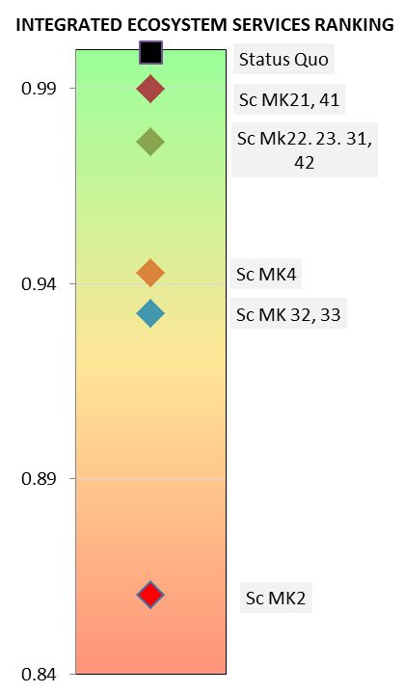
MKOMAZI CONSEQUENCES
Abundance of some importance fish sp decrease under some scenarios (eg yellow fish).
Riparian veg: Minor increase in some woodies. Mostly no change in utilisation. Sc 2 – most impact.
WQ: No change except waste assimilation.
Geomorph: Mostly no change as river deeply incised with few floodplains.
Estuary – possible impacts on some sc, especially 2, related to water quality, recreation, fishing

Slide 13
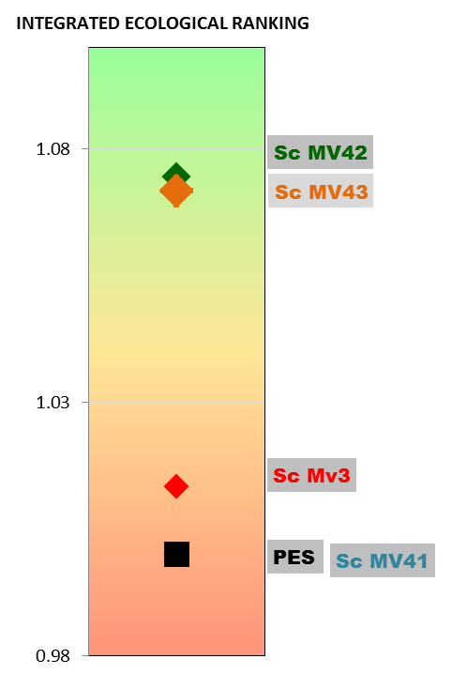
MVOTI CONSEQUENCES
Abundance of some importance fish sp decrease under some scenarios (eg yellow fish).
Riparian veg: Some increase in abundance in reeds, sedges etc in some scenarios, mostly no change
WQ: No change except for Sc 3 – potential for disease.
Geomorph: Reduced base flows and floods – flood attenuation, improvement of floodplain cultivation, etc – small increase in utilisation

Slide 14
ESS CONCLUSIONS
Changes are small at the Mkomazi and negative. I.e., although the utilisation is important, scenarios have minor impact on ESS.
Utilisation in the Mvoti mostly no change or very small improvements.
Weighting must still be included.
Estuary analysis must still be undertaken.
Doubtful whether any significant changes of this estimate.

